Slide 1
Hyperspectral imaging
The main objective of imaging spectroscopy is to measure the spectral signatures and/or chemical composition of all features within the sensor's field of view.
Each pixel across a sequence of continuous, narrow spectral bands, contains both spatial and spectral properties.
Pixels are sampled across many narrowband images at a particular spatial location within the "spectral cube", resulting in a one-dimensional spectrum.
The spectrum can be used to identify and characterize a particular feature within the scene, based on unique spectral signatures or "fingerprints".

Slide 2
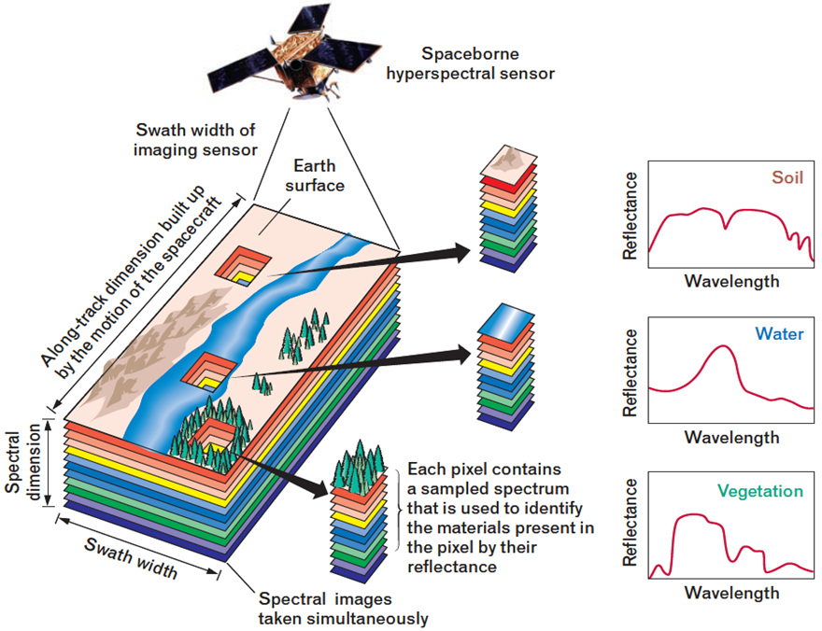
Source: http://www.markelowitz.com/Hyperspectral.html

Slide 3
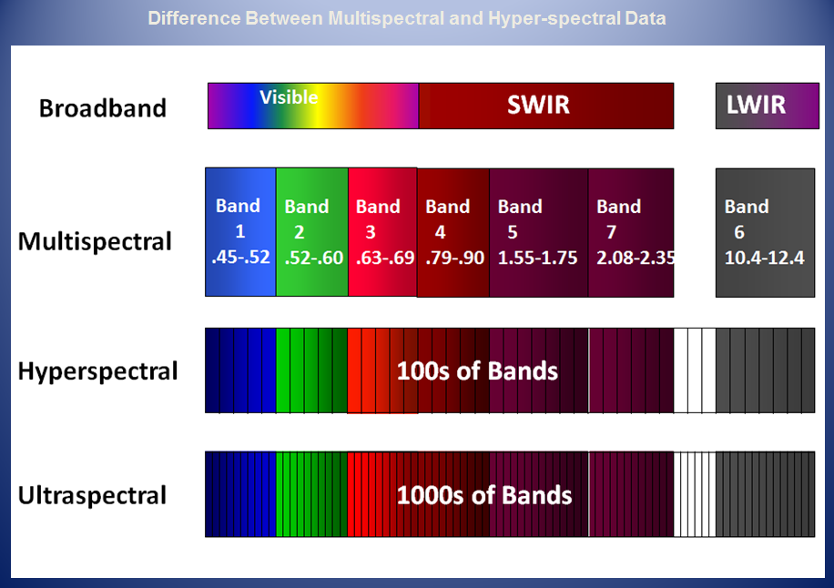

Slide 4
Data
Image data
Measured at 5 different vegetative stages in the crop cycle.
Measured using a multispectral camera, 62 wavelength bands between 400 to 850 nm.
Phenotypic data
465 maize hybrids tested in 12 trials (11 under heat-drought stress and 1 under well-watered condition).
Trials were laid in a alpha lattice design wit 2 or 3 replicates
Grain yield measured in ton/ha.

Slide 5
Fitting model
GitHub

Slide 6
NNL1: Lambda1=0.001, (50,40) nodes
NNL2: Lambda1=0.01, (50,40) nodes

Slide 7
Correlation between observed and predicted values for each trial and model

